Slide 1
GR 5243 Applied Data Science
Project 4 Algorithm Implementation and Evaluation
Yu, Chenghao (cy2475)
Team Members:
Chen, Jannie (mc4398) Chen, Sizhu (sc4248) Li, Yunfan (yl3838) Xu, Zhengyang (zx2229)

Slide 2
Flow chart
Preprocessing
Detection
Divide all detected error in 70% and 30% as training set and test set
Predict label scores for candidates in the test sets
Apply regression (AdaBoost with weighted loss function)
Replace candidate with the highest label score instead of error word
Evaluation

Slide 3

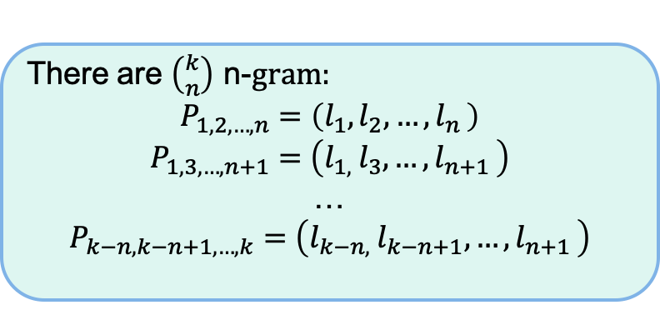
Detection: Binary n-Grams Method (D-2)
Idea:
Check whether letter pairs in the word at different positions exist in ground truth. If any pairs of letters are not in ground truth, the word is detected as error.
Concepts:
n-Grams
There are $\left({k \atop n}\right)$ n-$gram:$
$$P_{1,2,…,n}=\left(l_{1},l_{2},{…,l}_{n}\right)$$
$$P_{1,3,…,n+1}=\left(l_{1, }l_{3},{…,l}_{n+1}\right)$$
…
$$P_{k−n,k−n+1,…,k}=\left(l_{k−n, }l_{k−n+1},{…,l}_{n+1}\right)$$
A length n word $W$= $l_{1}l_{2}{…l}_{k}$

Slide 4
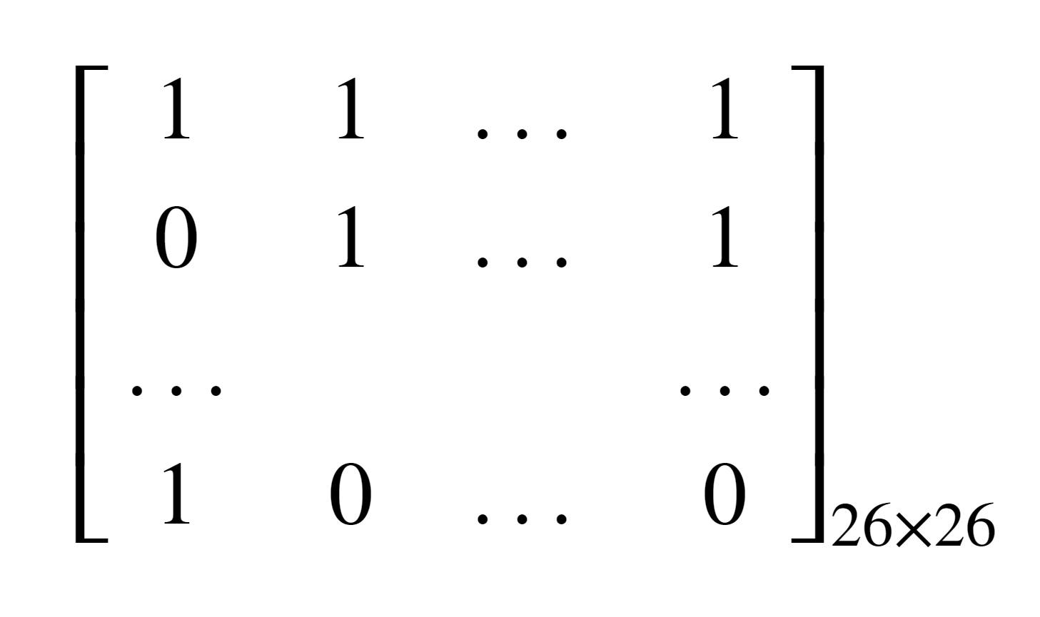
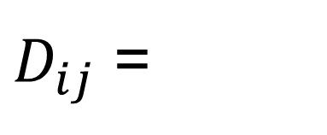
Detection: Binary n-Grams Method (Cont.)
Binary 2-gram Matrix:
a b … z
a b … z
$D_{ij}$ =

Slide 5




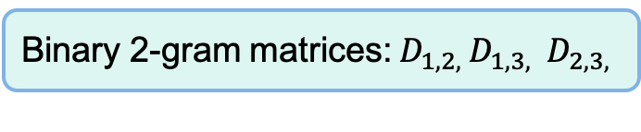
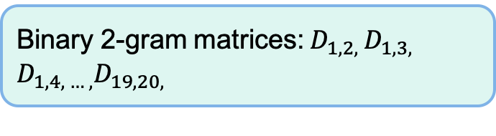

Detection: Binary n-Grams Method (Cont.)
Creating Binary Matrices:
Create all binary 2-gram matrices
Word length=2:
$W_{1}$, $W_{10}$, …, $W_{i}$
Binary 2-gram matrices: $D_{12}$
Ground truth text:
$W_{1}$, $W_{2}$, …, $W_{n}$
Word length=3:
$W_{2}$, $W_{8}$, …, $W_{j}$
Binary 2-gram matrices: $D_{1,2, }D_{1,3, }$ $D_{2,3, }$
…
Word length=20:
$W_{12}$, $W_{16}$, …, $W_{k}$
Binary 2-gram matrices: $D_{1,2, }D_{1,3, }$ $D_{1,4, … ,}D_{19,20, }$

Slide 6



Detection: Binary n-Grams Method (Cont.)
Detection:
Check letter pairs in binary 2-gram matrices of length n, if $D_{i,j}$ is 0 with $P_{i,j}$ pairs, then $D_{i,j}$ detected an error
A new word with length n: $W$
Get $\left({n \atop 2}\right)$ 2-gram letter pairs: $P_{1,2}$, $P_{1,3}$, … , $P_{n−1,n}$
Assumption:
Only one error in every ORC output word
Find union set of the locations where detected the error happened, the result is the error location in the word.

Slide 7
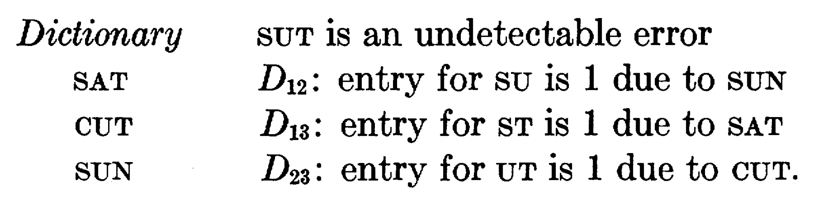
Detection: Binary n-Grams Method (Cont.)
Undetectable Case:

Slide 8
Detection: Binary n-Grams Method (Cont.)
Advantages:
Saving storage space
More efficient than dictionary based methods
Extendibility
Disadvantages:
Theoretical Undetectable case
Lower detection rate than dictionary based methods
Cannot detect errors in non-alphabetic languages

Slide 9
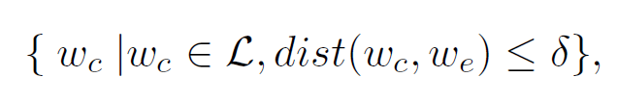
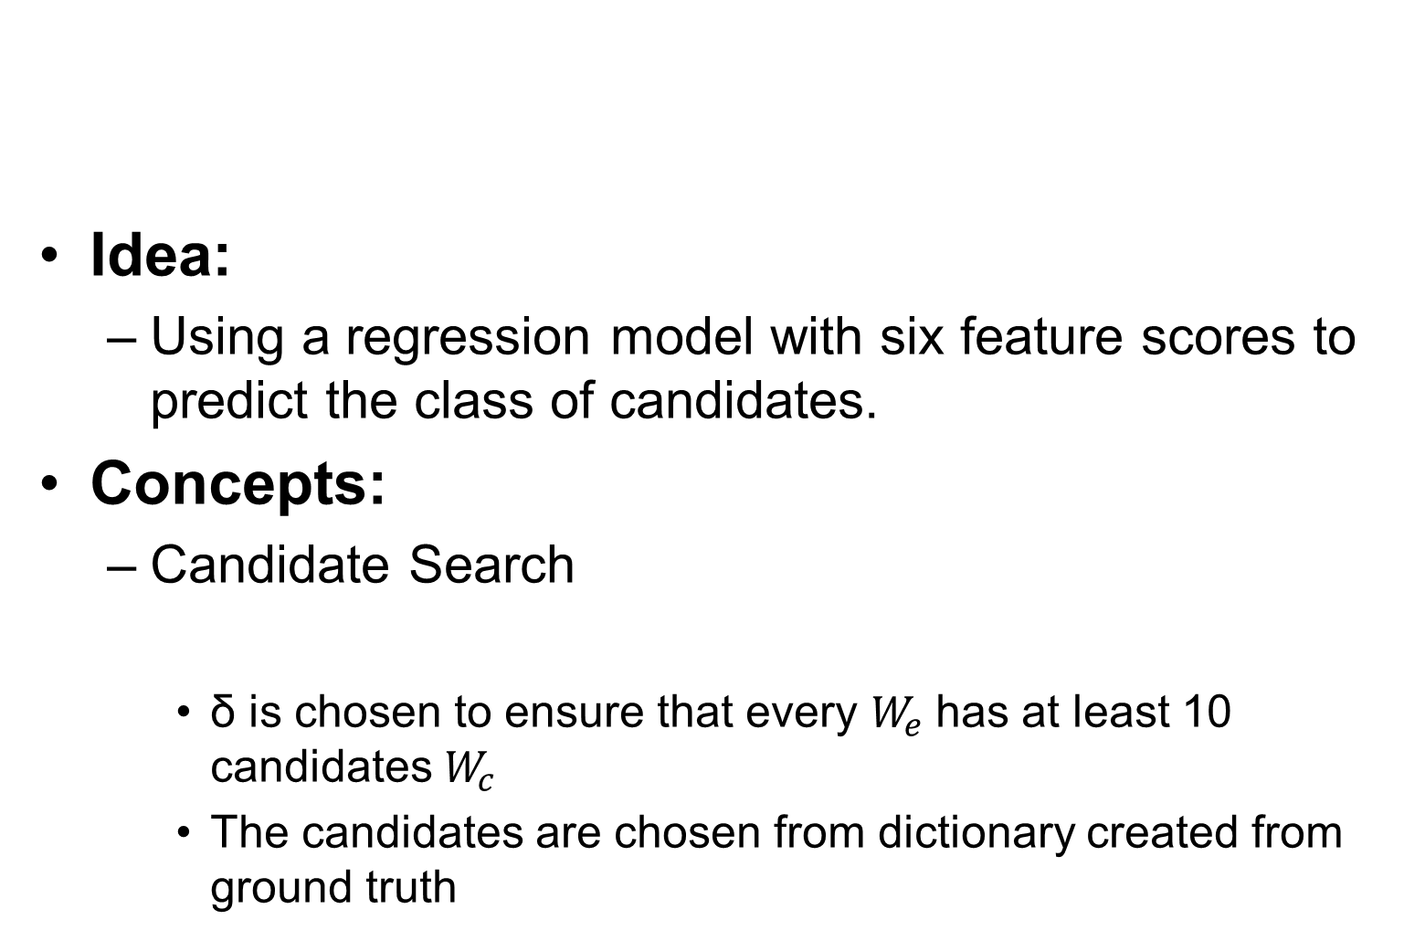
Correction: Statistical Learning Model (C-2)
Idea:
Using a regression model with six feature scores to predict the class of candidates.
Concepts:
Candidate Search
δ is chosen to ensure that every $W_{e}$has at least 10 candidates $W_{c}$
The candidates are chosen from dictionary created from ground truth
Damerau-Levenshtein distance

Slide 10
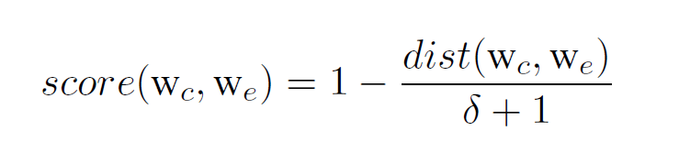
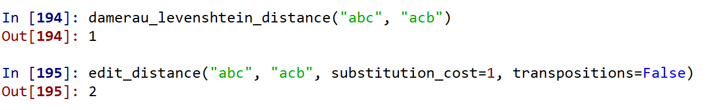
Correction: Statistical Learning Model (C-2)
Feature scores（some kinds of measurement of similarity between two strings):
Feature 1： Levenshtein edit distance score:
δ is set as the same as δ in candidates search so that this score will in [0,1] interval.
Levenshtein distance
Difference between two edit distance:

Slide 11
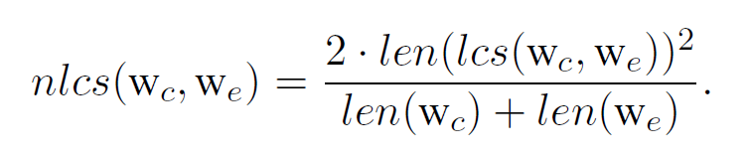
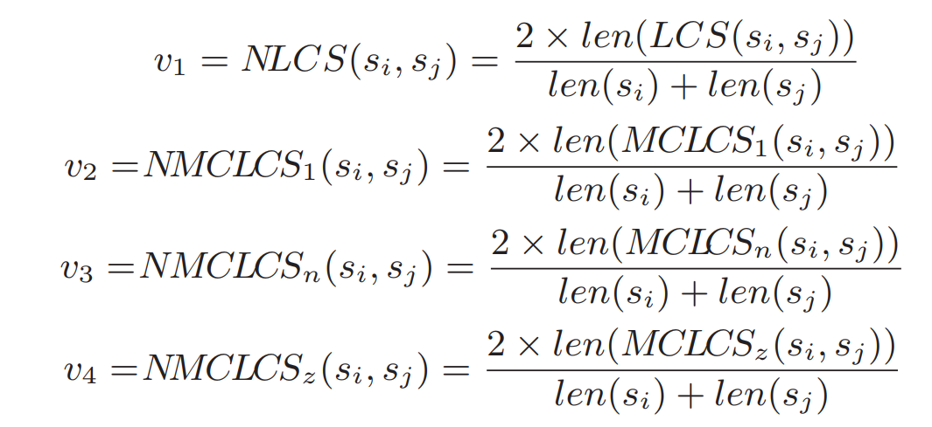
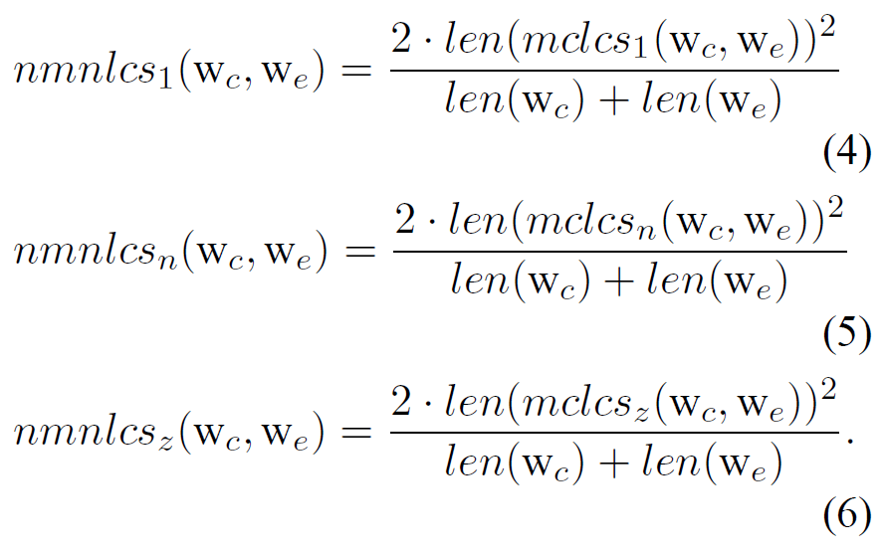
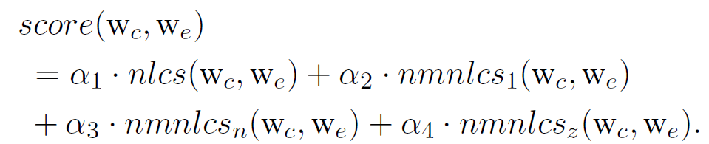
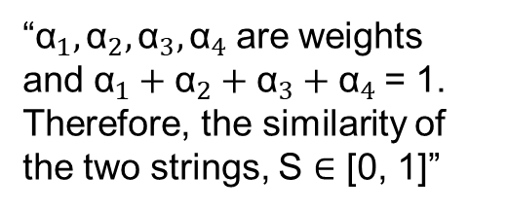
Correction: Statistical Learning Model (Cont.)
Feature 2： String similarity score:
C-2 paper:
Original paper:
“${\text{α}}_{1},{\text{α}}_{2},{\text{α}}_{3},{\text{α}}_{4}$are weights and ${\text{α}}_{1}+{\text{α}}_{2}+{\text{α}}_{3}+{\text{α}}_{4}$= 1. Therefore, the similarity of the two strings, S ∈ [0, 1]”
“We heuristically set equal weights for most of our experiments”

Slide 12
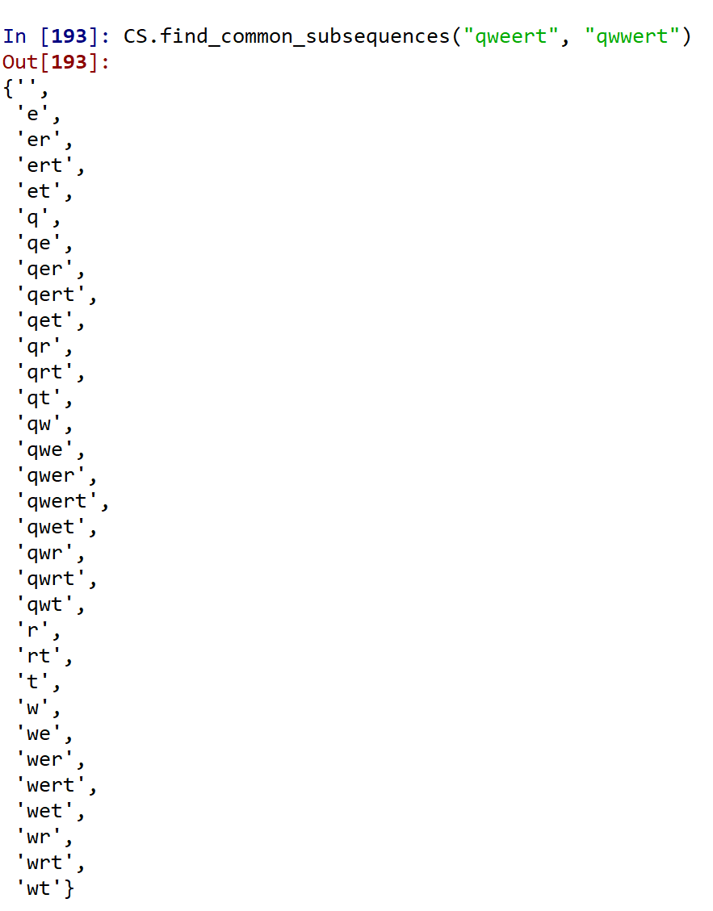


Correction: Statistical Learning Model (Cont.)
LCS: Longest Common Subsequence
lcs$,$ ${\text{mclcs}}_{1},{\text{mclcs}}_{z}$
$${\text{mclcs}}_{n}$$

Slide 13
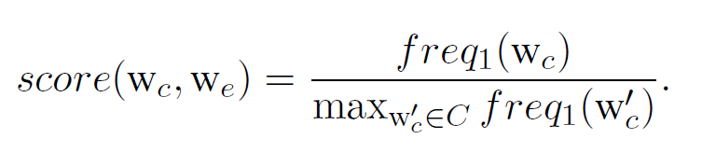
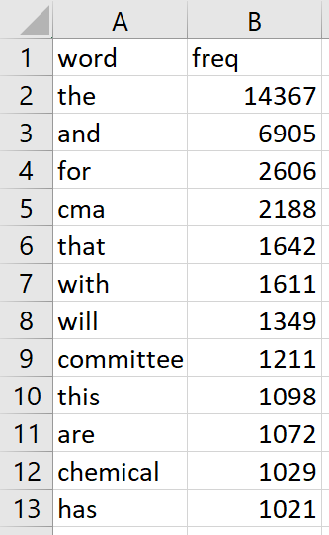
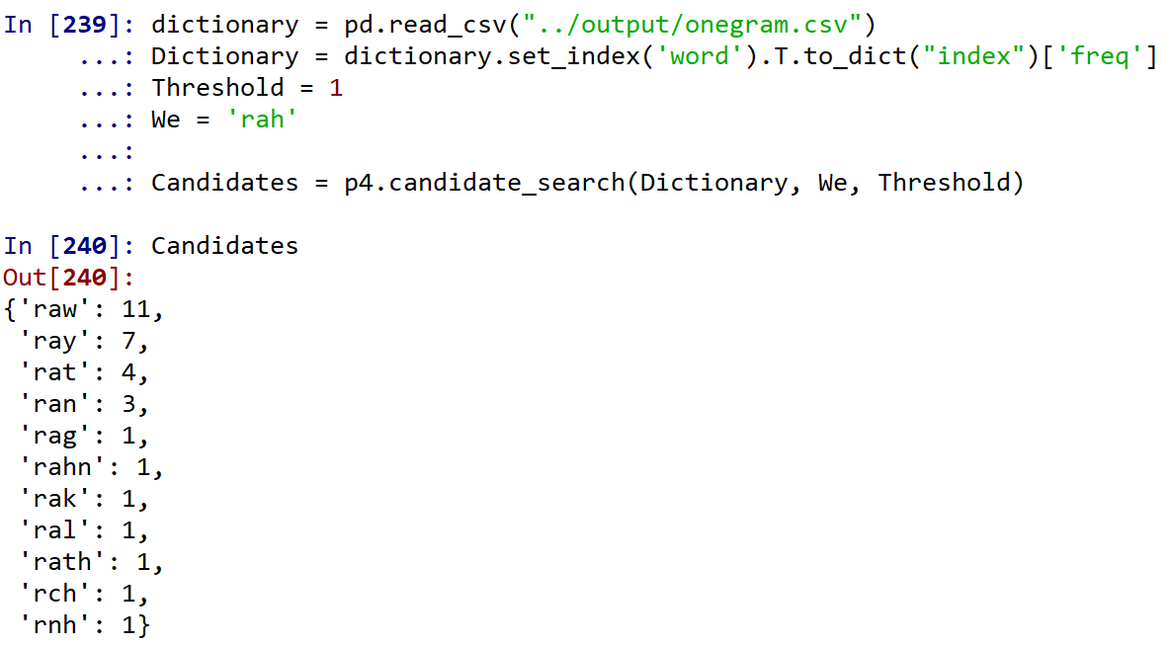
Correction: Statistical Learning Model (Cont.)
Feature 3： Language popularity score:
Dictionary:
Example:

Slide 14
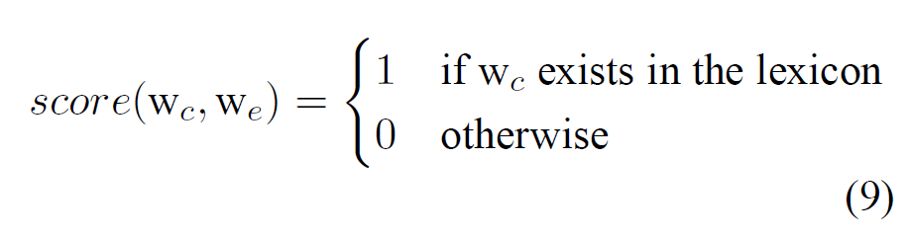
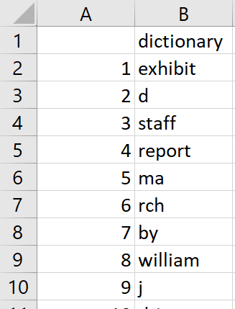
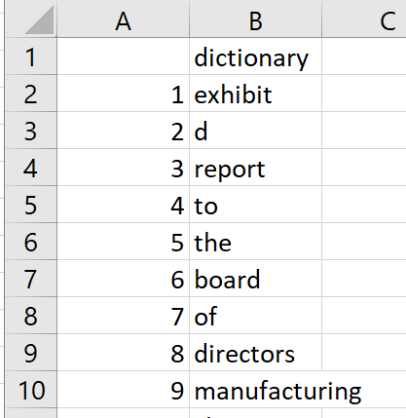
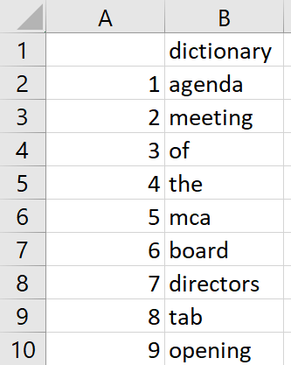

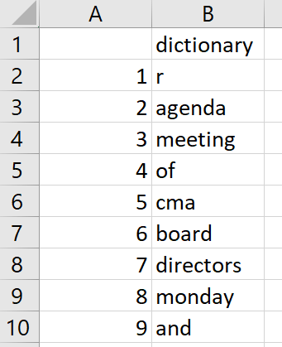
Correction: Statistical Learning Model (Cont.)
Feature 4： Lexicon existence：
A lexicon is corresponding to a topic, so we created our lexicons by the different report groups.
Group 1:
Group 2:
Group 3:
Group 4:
Group 5:

Slide 15
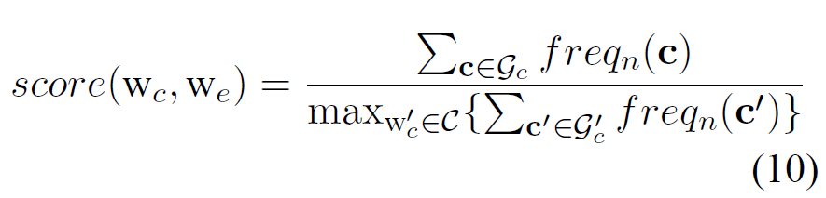
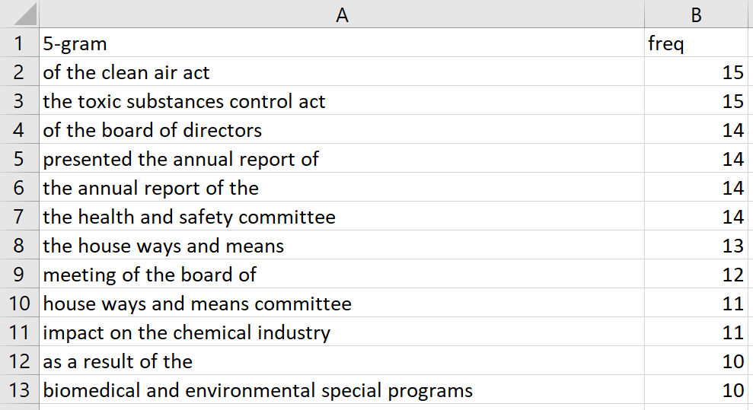
Correction: Statistical Learning Model (Cont.)
Feature 5： Exact-context popularity：
5-gram dictionary：
Not suitable for parallel processing:
5-gram need at least four successive correct words before or after error word to ensure we can find the 5-gram in dictionary given by ground truth.

Slide 16
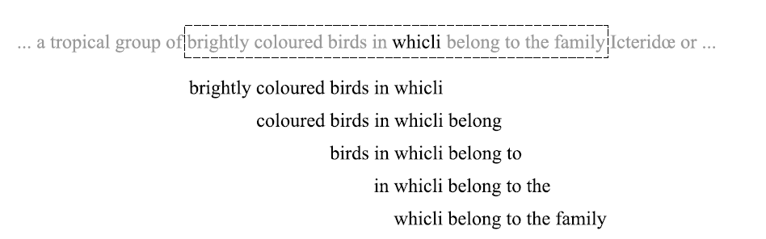
Correction: Statistical Learning Model (Cont.)
Feature 6： Relaxed-context popularity：
In 5-gram case, need to find the frequency of whole 4*5=20 relaxed 5-gram.

Slide 17
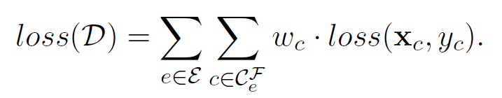
Correction: Statistical Learning Model (Cont.)
Regression model:
AdaBoost with weighted loss function to deal with unbalanced label problem
“We count the number of samples with label 1 and
0, respectively. Then, we use the ratio to weight
for samples labeled 1, and 1 for samples labeled 0.”

Slide 18
Correction: Statistical Learning Model (Cont.)
Advantage:
High correction rate
Disadvantages：
Cannot correct “separated word case”
Need more

Slide 19
Challenges
Preprocessing:
How to find the error-ground pair
Correction:
How to set a reasonable threshold for candidates search
Different formulas between papers
Weighted loss function in R

Slide 20
Evaluation
 | Tesseract | Tesseract with postprocessing
Word wise recall | 0.6550634 | 0.9457426
Word wise precision | 0.6550634 | 0.9457426
Character wise recall | 0.898704 | 0.9738515
Character wise precision | 0.9227921 | NA

Slide 21
Thank you

